Slide 1
Capstone Engagement
Assessment, Analysis, and Hardening of a Vulnerable System

Slide 2
Table of Contents
This document contains the following sections:
01
Network Topology
02
Red Team: Security Assessment
03
Blue Team: Log Analysis and Attack Characterization
Hardening: Proposed Alarms and Mitigation Strategies
04

Slide 3
Network Topology
‹#›

Slide 4
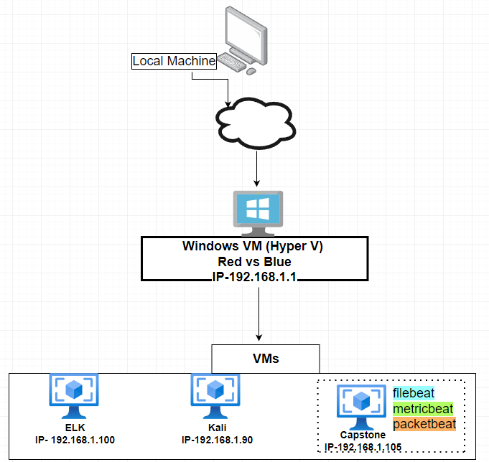
Network Topology
[Insert Here]
Use draw.io to create a diagram of the network.
Add your diagram to this slide and fill out the data in the sidebar.
z
Network
Address Range:192.168.1.0/24
Netmask:255.255.255.0
Gateway:10.0.0.1
Machines
IPv4:192.168.1
OS:Linux
Hostname:Red vs Blue
IPv4:192.168.1.100
OS:Linux
Hostname:Elk
IPv4:192.168.1.90
OS:Kali Linux
Hostname:Kali
IPv4:192.168.1.105
OS:Linux
Hostname:Capstone

Slide 5

Red Team
Security Assessment
‹#›

Slide 6
Recon: Describing the Target
Nmap identified the following hosts on the network:
Hostname | IP Address | Role on Network
Capstone | 192.168.1.105 | Target Machine using Apache Web Server
Kali | 192.168.1.90 | Attacking machine running on Kali Linux
Elk | 192.168.1.100 | Logging service capturing data and server activity.
Hyper V Manager | 192.168.1.1 | Software that contains and visualizes multiple virtual machines.

Slide 7
Vulnerability Assessment
The assessment uncovered the following critical vulnerabilities in the target:
Vulnerability | Description | Impact
Out of date software | Old version of Apache was being used without being patched. | Leaves vulnerabilities open to attackers to connect to the network.
Lack of password complexity | Users on the network lacked complex passwords ex.( numbers, characters, capitalization) | Created a weak point for the attacker to easily crack password to access confidential information.
Vulnerable ports open to public | Port 80 and port 22 showed as open to any source on an Nmap scan | Allowed the attacked to connect directly from the internet on their machine.

Slide 8
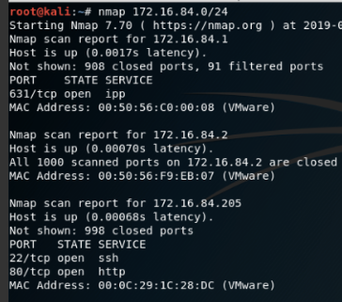
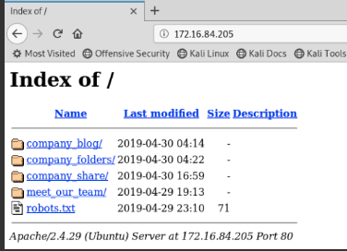
Exploitation: Open Vulnerable Ports
01
02
03
Tools & Processes
Ran an Nmap scan on the servers network.
Achievements
Showed port 80 and port 22 were open that allows any source to connect to the network.

Slide 9
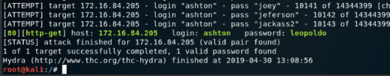
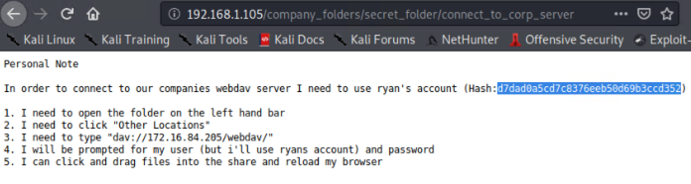
Exploitation: Lack of Password Complexity
01
02
03
Tools & Processes
Hydra was used to brute force attack the password for ashton
Achievements
Accessed /company_folders/secret_folder directory from the server.

Slide 10
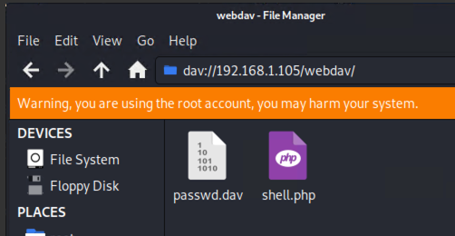
Exploitation: Out of Date Software
01
02
03
Achievements
Successful upload and activated a PHP reverse shell script to the WebDav directory.
Tools & Processes
Created a reverse shell with msfvenom. From there a listener was set up in Metasploit by creating a payload.

Slide 11

Blue Team
Log Analysis and Attack Characterization
‹#›

Slide 12

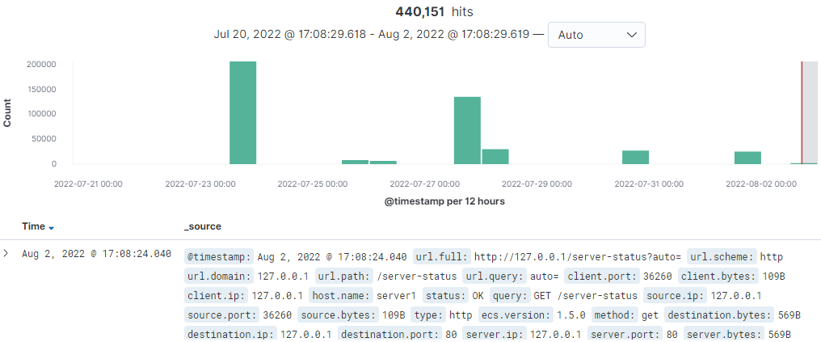
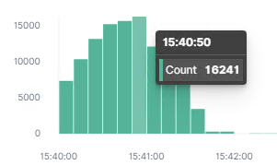
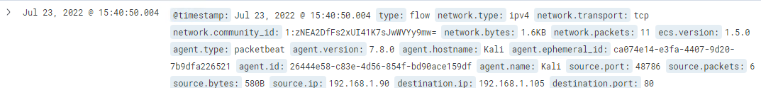
Analysis: Identifying the Port Scan
Answer the following questions in bullet points under the screenshot if space allows. Otherwise, add the answers to speaker notes.
What time did the port scan occur? 3:40pm
How many packets were sent, and from which IP? 11 packets from IP: 192.168.1.90
What indicates that this was a port scan? The HTTP request through port 80.

Slide 13
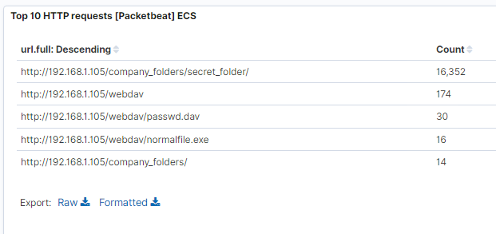
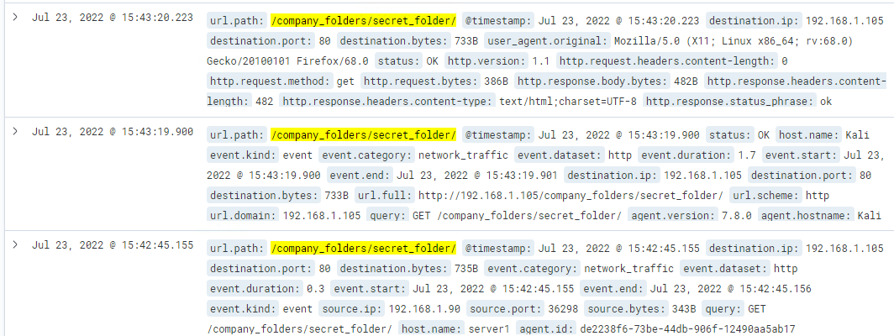
Analysis: Finding the Request for the Hidden Directory
Answer the following questions in bullet points under the screenshot if space allows. Otherwise, add the answers to speaker notes.
What time did the request occur? July 23rd 2022 @ 3:43 pm
How many requests were made? 16,352
Which files were requested? /company_folders/secret_folder/
What did they contain? The secret folder contained a password hash for the user Ryan.

Slide 14
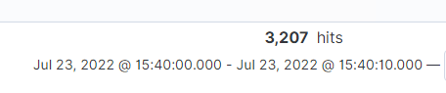
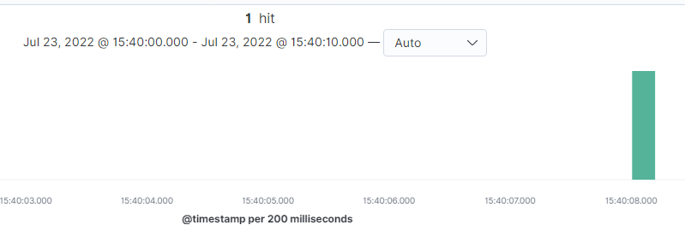
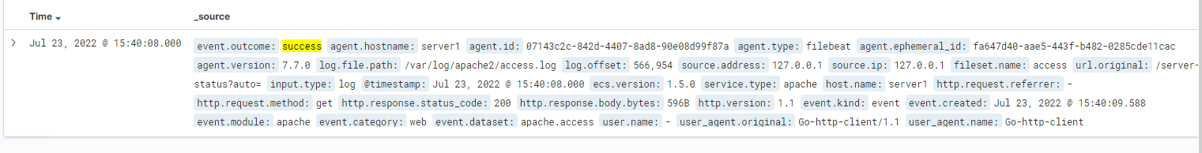
Analysis: Uncovering the Brute Force Attack
Answer the following questions in bullet points under the screenshot if space allows. Otherwise, add the answers to speaker notes.
The file was requested 3,207 times before the attacker successfully requested the file 1 time July 23rd 2022 @ 3:40pm.

Slide 15
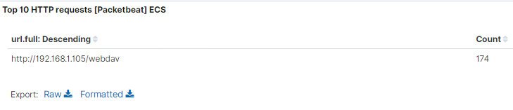
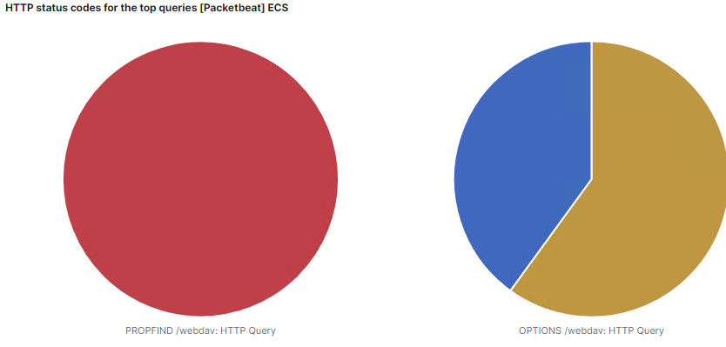
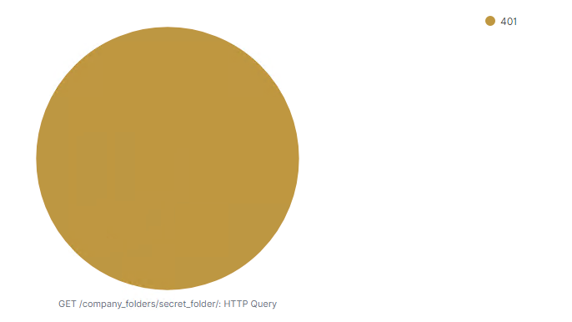
Analysis: Finding the WebDAV Connection
Answer the following questions in bullet points under the screenshot if space allows. Otherwise, add the answers to speaker notes.
How many requests were made to this directory? 174 requests
Which files were requested? HTTP query for GET /company_folders/secret_folder/

Slide 16
Blue Team
Proposed Alarms and Mitigation Strategies
‹#›

Slide 17
Mitigation: Blocking the Port Scan
What kind of alarm can be set to detect future port scans?
Setting an alert for scan and sweep filters to capture high levels of port scans from a single IP.
What threshold would you set to activate this alarm?
Placing a threshold value determined off of baseline activity for connection attempts from a specific IP. Once the threshold is met the alert is sent.
What configurations can be set on the host to mitigate port scans?
Deploying adaptive firewalls.
Also setting up filters to block port scans.
Describe the solution. If possible, provide required command lines.
Adaptive firewalls block ports when malicious IPs are trying to scan them.
Filters for 7000-7003 ( TCP / UDP port scan / host sweeps ), as well as 7004 and 7016 ( ICMP & ICMPv6 host sweep ).

Slide 18
Mitigation: Finding the Request for the Hidden Directory
What kind of alarm can be set to detect future unauthorized access?
An alert can be put in place for any IP address that’s not authorized to access this file / directory.
What threshold would you set to activate this alarm?
The threshold would be 1, met by any machine IP not whitelisted for this directory.
What configuration can be set on the host to block unwanted access?
Only allowing this directory to be accessed by certain IPs.
Describe the solution. If possible, provide required command lines.
Open Apache Configuration File.
Restrict Access by IP. Once you have opened the appropriate configuration file, look for <Directory> tag.
Restart Apache web server

Slide 19
Mitigation: Preventing Brute Force Attacks
What kind of alarm can be set to detect future brute force attacks?
A 401 Unauthorized alert can be created for the server.
What threshold would you set to activate this alarm?
When a baseline of 5 over a 1 hour period is met, the alert would then be triggered.
What configuration can be set on the host to block brute force attacks?
Allowing only a certain amount of failed login attempts.
Using MFA (Multi Factor Authentication )
Describe the solution. If possible, provide the required command line(s).
Alter account policies for logins on the server.
Implement a multi factor authentication process for user logins.

Slide 20
Mitigation: Detecting the WebDAV Connection
What kind of alarm can be set to detect future access to this directory?
Setting an alert when any attempt is made to access this directory outside of the whitelisted IPs.
What threshold would you set to activate this alarm?
Creating a range for accepted IPs.
Setting a threshold of 1 attempt for any unauthorized IPs.
What configuration can be set on the host to control access?
Creating a firewall rule to protect this directory.
Not allowing access to this directory from the web, especially from a non-local source.
Describe the solution. If possible, provide the required command line(s).
Blacklisting all IPs outside of Whitelisted IPs.
Blocking port 80 and 443.

Slide 21
Mitigation: Identifying Reverse Shell Uploads
What kind of alarm can be set to detect future file uploads?
Setting up an alert for .php files uploaded to the server, as well as an alert for the firewall including traffic going through port 80, 443, and 4444.
What threshold would you set to activate this alarm?
The threshold would be for any .php files, and any traffic moving through / trying to connect to port 80, 443, and 4444, triggering the set alarm.
What configuration can be set on the host to block file uploads?
Taking away the ability to upload any type of files from the web, and only allowing uploads from a local source.
Describe the solution. If possible, provide the required command line.
Block port 80, 443, and 4444.

